Slide 1
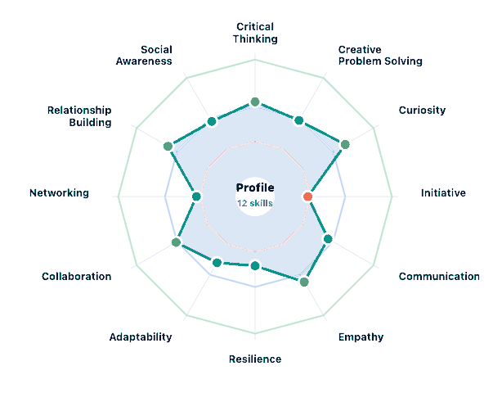
COACH VIEW · PROFILE GLANCE
What this student's profile looks like
Engine and Fuel profile
ENGINE
How they focus, plan, and shift gears — and the fuel they have to draw on.
How they focus, plan, and shift
Holding the plan
Building
Pause before reacting
Start Here
Switching gears
Working For You
FUEL
Context for how to coach the engine work
Real choices
Building
People in your corner
Working For You
Effort pays off
Building
Engine = concrete, scaffold-able skills. Fuel = context that shapes how you coach the engine work. Profile is illustrative.

Slide 2
COACH VIEW · WHAT THE STUDENT SAW
The exact language the student is reading
INITIATIVE
Strength band · Direct skill building
Anchor sentence
Simple things you can try
“You may know what comes next and still find yourself waiting to start.”
Pick one. Try it this week.
1
Write the first step at the bottom of every plan.
Where to focus next
After any plan or to-do list, add: “First step: [specific action I will do in the next [timeframe]].” Then do that step before you close the note.
You make solid plans. You care about what you’re working on. When conditions are right, you get things done.
Where the gap shows up is in the moment between deciding to start and actually starting.
It’s not missing motivation. It’s that turning a decision into a first step isn’t automatic yet. Building the habit of immediate implementation is what closes it.
2
Use an if-then statement for tasks you keep delaying.
“When I sit down at my desk after lunch, I will open the project doc and write the first sentence.” Put the trigger somewhere visible.
3
Start the two-minute version before you start the real version.
Open the doc. Write one sentence. Make one call. Start the timer. After two minutes, you can stop. You usually won’t.
The plan is already yours.
The first step fires the rest.
That’s how it builds.
Verbatim from the student-facing report. Coach reads what the student read — no paraphrase.

Slide 3
COACH VIEW · WHAT THEY COMMITTED TO
The strategy the student picked
CONTEXT
THE COMMITMENT
Skill
What the student wrote, in the student's own words
Initiative
At the bottom of every plan, the student writes:
Engine read
First step: [specific action I will do in the next [timeframe]]
Pause before reacting is the constrained component.
Then do that step before closing the note.
Fuel read
Strong relatedness. Use it as the lever.
Verbatim from Strategy 1 in the student-facing report.
STRATEGY CHOSEN
WHY THIS WORKS
Strategy 1
Specifying the first step at plan-time removes the gap between planning and starting. The decision is already made.
Write the first step at the bottom of every plan.
V1 surfaces the profile, the student's chosen strategy, and what they actually wrote. The coach weaves the connection in conversation.

Slide 4
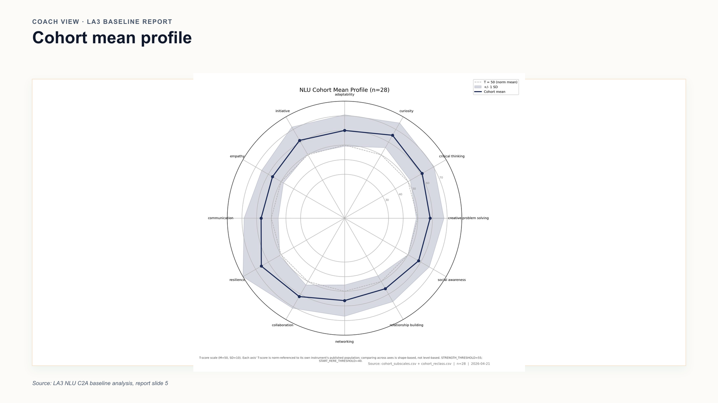

Slide 5
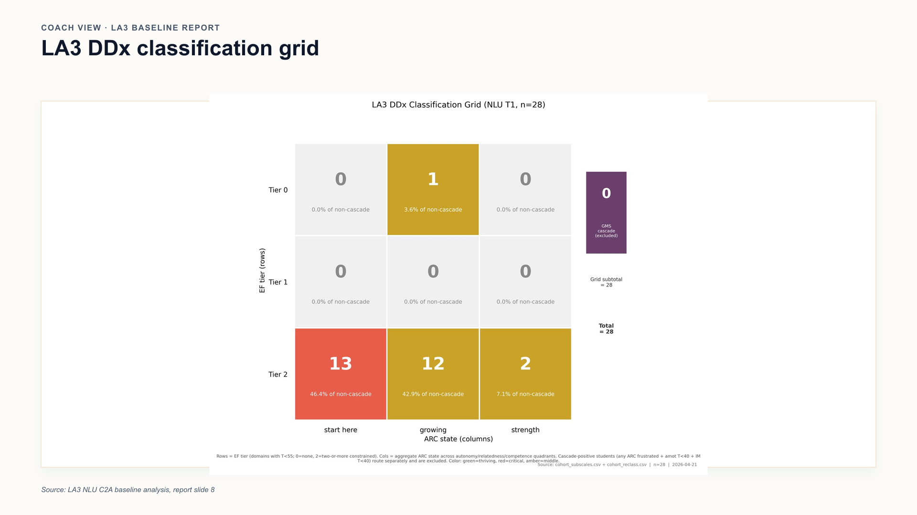

Slide 6
